Slide 1
TEBONG ROLAND DSC 640 –T302 Data Presentation & Visualization (2241-1) Air Craft & Road Accidents 2021
An Executive Summary

Slide 2
Introduction
Welcome to our Executive Summary presentation on air travel safety in 2021. In light of recent negative media coverage and public concerns regarding aviation safety, we have conducted a comprehensive analysis to provide clarity and transparency.
Today, we will delve into the findings that unequivocally demonstrate that air travel remains one of the safest modes of transportation. Our presentation will highlight key insights from our data analysis and our commitment to responsible and ethical communication.
As senior leaders in our organization, you play a pivotal role in shaping the narrative surrounding the aviation industry and our airline specifically. This presentation will not only set the tone for how we address media inquiries but also guide our approach in ensuring that the information we share is truthful, factual, and devoid of misleading narratives.

Slide 3
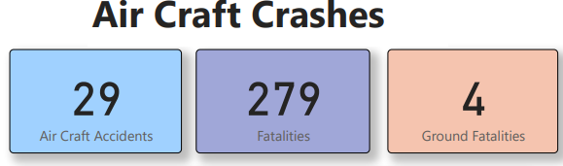
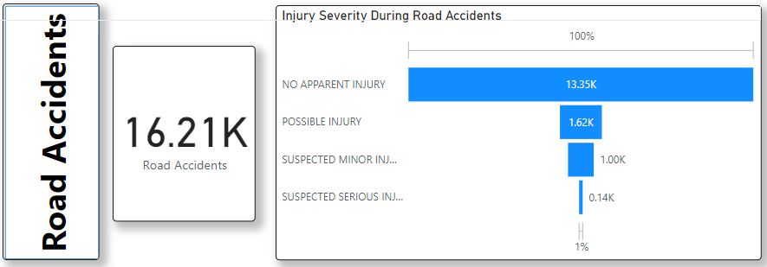
Aircraft vs. Road Accidents
We can visualize a side-by-side comparison of aircraft accidents and road accidents in 2021.
It clearly depicts the Airline is far better then road travelling.

Slide 4
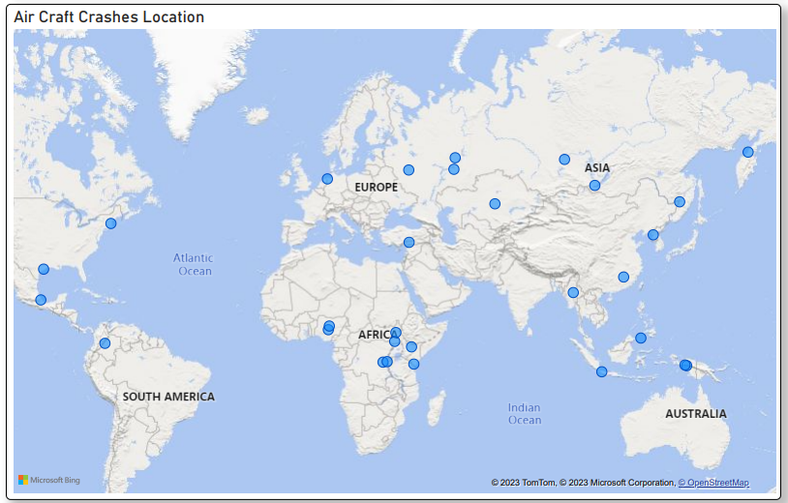
Geographical Distribution
We can observe the world map with markers indicating aircraft crash locations.
The crashes are not concentrated in one region but rather distributed globally.

Slide 5
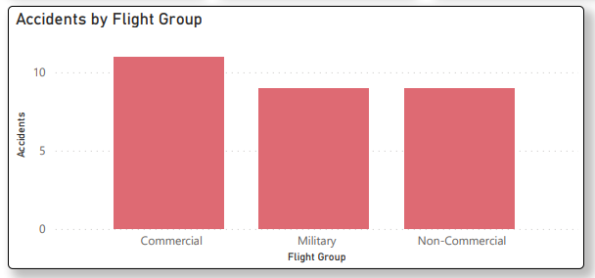
Accidents by Flight Groups
It can be observed that crashes were not only for commercial flights.
Some of the crashes were Military and Non-Commercial which depicts that the airlines are still the safest to travel.

Slide 6
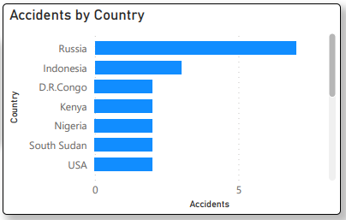
Accidents by Country
The chart below displays the number of aviation accidents reported in various countries.
Russia and Indonesia stand out with the highest number of accidents, indicating areas of potential focus for safety measures.
The distribution of accidents across multiple countries emphasizes the need for a global perspective when addressing safety concerns

Slide 7
Future Risks and Position
To ensure the ongoing safety and success of our airline, it is crucial to proactively identify and mitigate potential risks. Our data analysis enables us to anticipate emerging trends, allowing us to stay ahead of safety challenges
We recognize the importance of maintaining a strong dialogue with our shareholders. By sharing accurate data and insights, we not only build trust but also foster a collaborative environment for addressing safety concern.

Slide 8
Conclusion
In summary, our data-driven analysis for 2021 underscores that air travel remains one of the safest modes of transportation globally.
Aircraft accidents, when compared to road accidents, reveal a significant difference in incident numbers and fatalities, reaffirming the safety of air travel.

